Slide 1


Flight Fare Prediction

Slide 2

Project Overview
Objective :
The primary objective of the flight fare prediction dashboard is to provide travelers with actionable insights into airfares, helping them identify the optimal times to book flights and avoid overpaying. By utilizing data visualization, the dashboard aims to uncover patterns and trends in ticket prices, thus enabling users to make informed decisions and potentially save money.

Slide 3
Data Description
Data Source :
The data for the flight fare prediction dashboard is sourced from Kaggle, a platform known for its diverse and high-quality datasets.
Data Attributes :
The dataset will include details such as flight routes, departure/arrival times, airline, seat class, and other relevant factors that may impact flight pricing.

Slide 4
Detailed Steps and Overview
Data Acquisition:
Collected historical flight data from various sources including Kaggle. Before processing, the data is verified for its authenticity and integrity.
Data Preprocessing:
The dataset was cleaned by removing null values ​​and outliers. Added styling to incorporate related attributes such as flight duration and departure time categories.

Slide 5
Dimensions and Features Used
Flight Routes: Origin, Destination
Dates and Times: Departure, Arrival, Weekdays, Seasons
Airline: Operating Airlines
Seat Class: Economy, Business, First Class
Prices: Historical Prices, Trends
Additional Factors: Promotions, Holidays, Events

Slide 6
.
Use Cases
1
Leisure Travelers
A traveler planning a vacation can use the dashboard to
Find the best time to book flights, ensuring they get the
lowest possible fare by analyzing seasonal variations and
price predictions.
2
Business Travellers
A frequent business traveler can use the occupancy and
availability analysis to select flights that are less crowded,
enhancing their travel comfort and efficiency.
3
Travel Agencies
Travel agencies can leverage the dashboard to offer clients the best flight options by using fare prediction and route optimization data, providing added value to their services.
4
Airline Revenue Management
Airlines can use the anomalies detection and occupancy analysis to adjust pricing strategies dynamically, optimizing revenue based on seat demand and booking patterns.

Slide 7
Flight Dashboard
1
Average Flight Ratings by Airlines
Provides a comparison of customer satisfaction across different airlines. Understanding these ratings helps identify high-performing airlines and those needing service improvements.
2
Occupancy and Availability Seat Analysis
Highlights the number of seats booked versus available for specific flights. Analyzing this data helps understand flight demand and optimize seat allocation to maximize occupancy.
3
Top 5 Costliest Flights
Lists the most expensive flights, providing insights into premium routes. This information helps strategize pricing models for high-demand routes to maximize revenue.

Slide 8
Flight Dashboard
4
Top 5 Cheapest Flights
Identifies the least expensive flights, offering insights into budget travel trends. Useful for marketing and promotional strategies targeting price-sensitive customers.
5
Occupancy Rate by Season and Day of the Week
Provides an understanding of seasonal and weekly variations in flight occupancy. Analyzing these patterns helps in forecasting demand and optimizing flight schedules and pricing strategies.
6
Seasonal Variation in Price
Highlights how flight prices vary throughout the year. Recognizing these trends aids in dynamic pricing strategies, allowing adjustments based on expected demand to maximize revenue.

Slide 9
Ticket Dashboard
1
Price Fluctuations
Airlines typically offer lower Price for tickets booked well in advance. Last-minute prices can be significantly higher due to increased demand.
2
Class preferences
Trends in choosing seat classes Economy, Business, or First Class. The price of airline tickets varies significantly based on class selected.
3
Booking Patterns
Identify booking trends, such as lead times, class preferences, and last-minute purchases, to optimize inventory management.

Slide 10
Route Dashboard
1
Busiest Routes
Busiest routes is particularly valuable due to high demand and significant price fluctuations.
2
Carriers by Route
Carriers by route provides insights into the competitive landscape of specific routes to strategize route planning, pricing, and marketing.
3
Route Analysis
Identify the most popular routes based on the number of seats booked and provides valuable insights into route performance, demand patterns, and passenger preferences.

Slide 11
Pricing Prediction Dashboard
1
Pricing Prediction
Provides a forecast of flight prices for the next month. Understanding these trends helps anticipate price fluctuations and optimize ticket purchasing strategies to take advantage of lower prices.
2
Anomalies Detection (Based on Seats Booked)
Identifies unusual patterns in seat bookings that could indicate irregular demand or booking behaviors for the next month. Monitoring these anomalies helps adjust strategies to ensure seat availability and optimize pricing.

Slide 12
Key Takeaways
Applied Theoretical Knowledge in Data
analysis and visualization to solve
real-world problems
Collaborating with team members was crucial in sharing ideas, dividing tasks, and ensuring the project was completed efficiently.
Gained hands-on experience with Power BI, enhancing proficiency in using this powerful tool for data visualization and analysis.
Developed dashboards that provide clear, actionable insights to aid decision-making and Improved ability to present complex data in an easily understandable manner through visualizations.

Slide 13
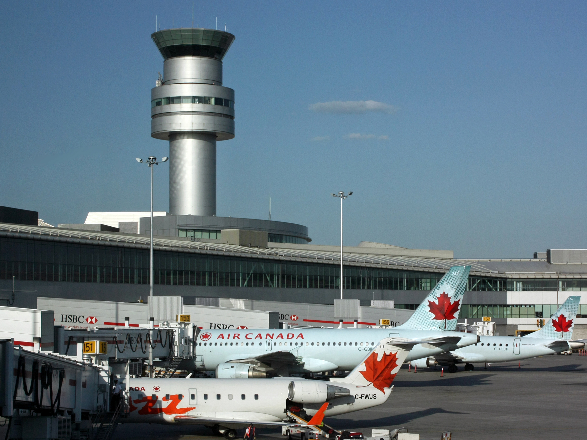
Conclusion
By leveraging the powerful data visualization and predictive capabilities of Power BI, this flight fare pricing project will provide airlines and passengers with valuable insights and accurate price forecasts, ultimately enhancing the overall travel experience.

Slide 14


